Slide 1

« Emotion Recognition & Genuineness Detection »

Slide 2
Table of contents
01
About the project
02
Emotion Recognition
03
Genuineness Detection
04
Result
T
0

Slide 3
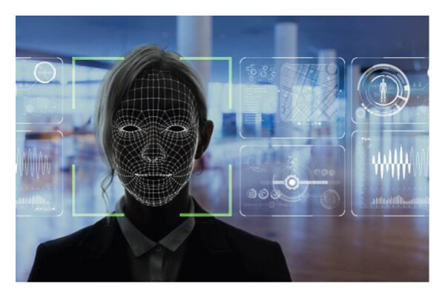

About the project
02
This project aim to explore two different tasks in the field of facial expression:
Emotion Recognition: Identifying the emotional state of a person based on their facial expression.
Genuineness Detection: Determining whether the expressed emotion is genuine or deliberately posed
T
1

Slide 4
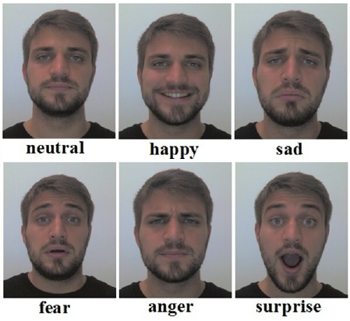
Emotion Recognition
02
For that task we have built a Convolutional Neural Network (CNN) model to classify facial expressions into one of seven basic emotions: Angry, Disgust, Fear, Happy, Sad, Surprise, and Neutral
The FER-2013 dataset, widely used in the research community for its diversity and complexity, is employed for training and evaluation
T
2

Slide 5
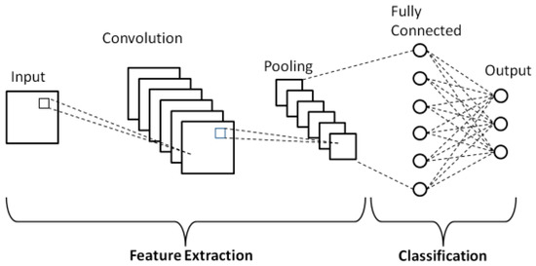


Model architecture
convolutional layer
Batch Normalization
activation function
3 convolutional blocks + 2 fully connected layers
Max pooling
Dropout
T
2

Slide 6
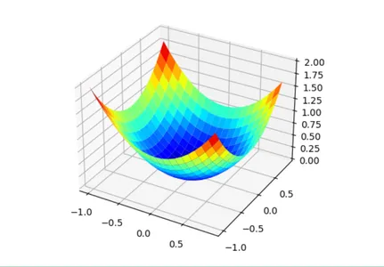
Model Training and testing
Cross entropy loss
Applies softmax and compute negative log-likelihood, ideal for multiclass classification
adam
Standard optimizer, used with a 0.001 learning rate
dataset
Is splitted into train_dataset, val_dataset and test_dataset
T
2

Slide 7
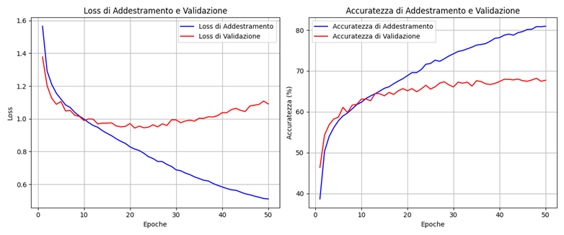
Accuracy and loss plots
T
2

Slide 8
03
Genuineness detection
How can we detect whether a facial expression is genuine?
…By observing involuntary facial microexpressions.
T
3

Slide 9
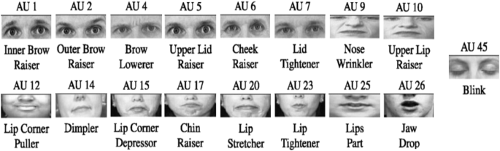
Action units
Action Units are movements of facial muscles, as defined in the Facial Action Coding System (FACS), each AU corresponds to a specific muscle contraction.
Some AUs (like AU6 in a genuine smile) are hard to fake, making them useful for detecting true emotions.
T
3

Slide 10
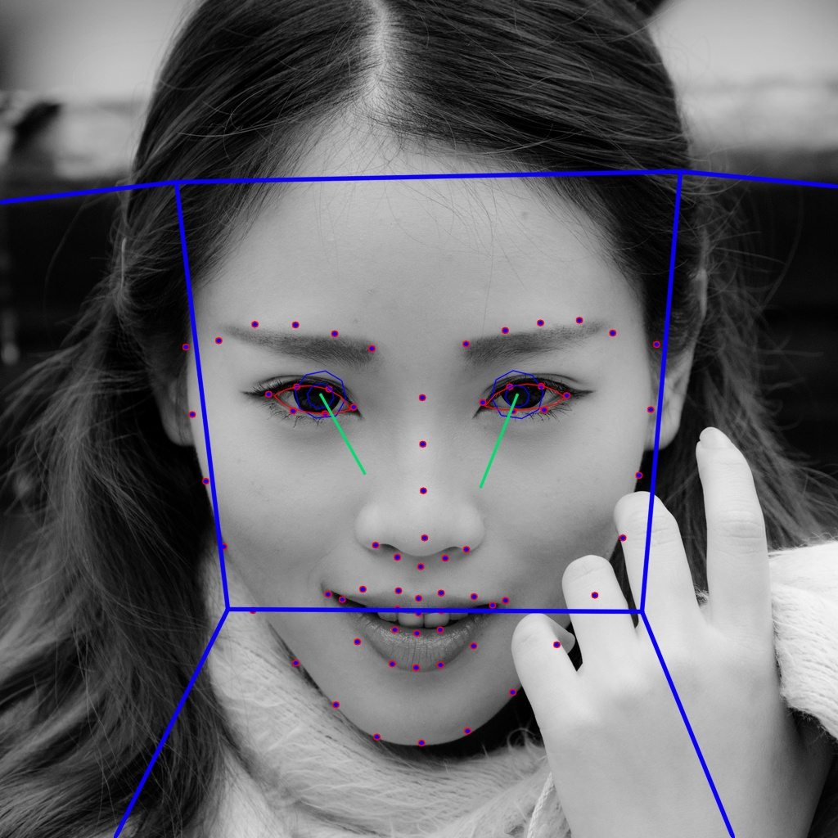
Open face
OpenFace is an open-source facial behavior analysis toolkit. Although it offers multiple functionalities, we used it solely to extract Action Units (AUs) from images.
It detects both the presence and intensity of each AU, however, we retained only the intensity values for our analysis.
T
3

Slide 11
Build the dataset
No suitable public dataset was available, so we created a custom one
Step 02
Step 04
Identify a dataset with genuine facial expressions
Combine the extracted data and assign the corresponding labes
Step 01
Step 03
Identify a dataset with posed facial expressions
Use OpenFace to extract facial Action Units
T
3

Slide 12

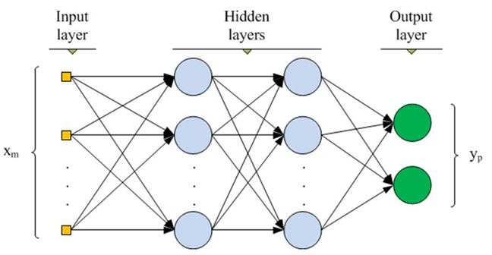
The model (mlp)
T
3

Slide 13
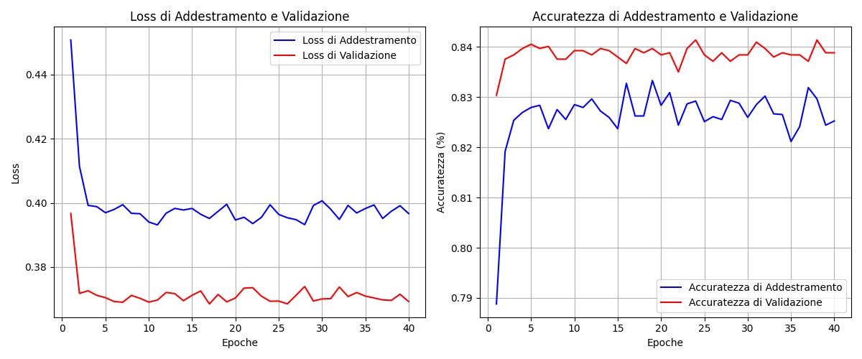
Accuracy and loss plots
T
3

Slide 14
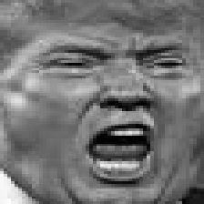

Model bias
Although the model achieved high accuracy, its performance is not consistently reliable due to discrepancies between the two datasets used.
Despite both being 224 x 224 grayscale images noticeable differences images style are evident between them
Left image from posed
Right image from genuine
T
3

Slide 15
04
results
Despite some challenges along the way, we developed two different models—a CNN and an MLP—each tailored to its specific task.
When tested in real scenarios, we found that while the models aren't perfect and do make occasional mistakes, they perform well in most cases.
Overall, we are proud of the work we have accomplished
T
4

Slide 16
Final workflow
Run the main.py
Emotion recognition
01
02
This will load the models and activate the webcam for real-time inference
When a face is detected, the CNN model recognizes the emotion in real time
Genuineness detection
Final result
03
04
To obtain the genuineness press «A», AUs will then be extracted and fed to the model
A freeze frame will show the emotion label and a true / false value indicating genuineness
T
4

Slide 17
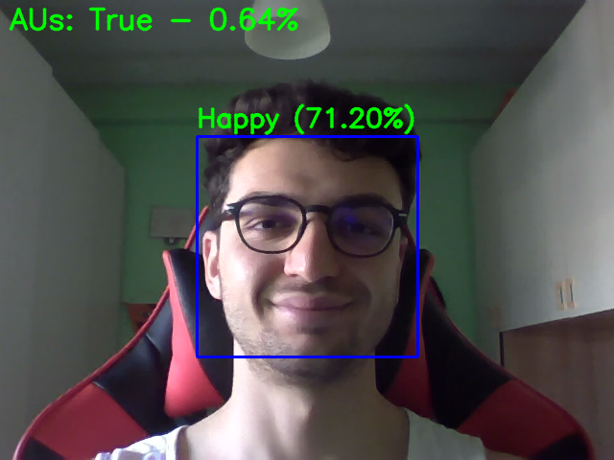
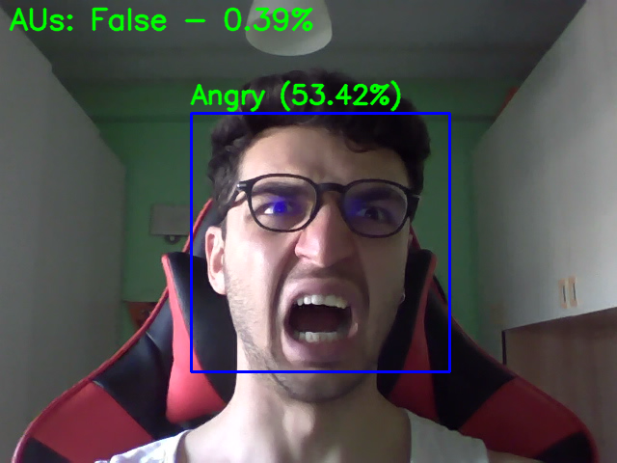
Show the results
Why do you smile?
Take it easy bro..
T
4

Slide 18


Do you have any question for us?
T
4

Slide 19

Thanks so much for listening!
Hope you enjoyed the presentation, and good luck when it’s your turn!
T
4

